Slide 1
Non – Recursive
QuickSort

Slide 2
The previous recursive implementation of QuickSort() is tail recursive.
void QuickSort (ItemType values[], int first, int last)
{
int splitPt1, splitPt2;
if (first < last)
{
Split(values, first, last, splitPt1, splitPt2);
//values[first]..values[splitPt2]<= splitVal
//values[splitPt1]..values[last]>= splitVal
QuickSort(values, first, splitPt2);
QuickSort(values, splitPt1, last);
}
}

Slide 3
As we know this can be removed by changing the values of the parameters to those specified in the recursive call and repeating the whole procedure.
void QuickSort (ItemType values[], int first, int last)
{
int splitPt1, splitPt2;
while (first < last)
{
Split(values, first, last, splitPt1, splitPt2);
//values[first]..values[splitPt2]<= splitVal
//values[splitPt1]..values[last]>= splitVal
QuickSort(values, first, splitPt2);
first = splitPt1;
}
}

Slide 4
How can the second recursive call be removed?
This is achieved by stacking, i.e. instead of the recursive calls keeping track of the segments that have yet to be sorted, these are kept on a stack within the function.
In this case the stack is implemented using an array.

Slide 5
void QuickSort (ItemType values[], int first, int last)
{
const int MAX_STACK = 20;
int splitPt1, splitPt2;
int stackTop, stack[MAX_STACK];
// Push the bounds of the array onto the stack so
// that the stack is not empty to start.
stack[0] = first;
stack[1] = last;
stackTop = 1;

Slide 6
// Segements still to sort – Stack Empty?
while (stackTop > -1)
{
// Pop the set of bounds on top of the stack
last = stack[stackTop];
first = stack[stackTop - 1];
stackTop -= 2;

Slide 7
// Spit the current segment if it contains
// more than one element
while (first < last)
{
Split (values, first, last,splitPt1, splitPt2);
// values[first]..values[splitPt2] <= splitVal
// values[splitPt1]..values[last] >= splitVal

Slide 8
// Push the LH segment bounds onto the stack
stack[stackTop+1] = first;
stackTop += 2;
stack[stackTop] = splitPt2;
// Continue on working with the RH segment
first = splitPt1;
}
}
}

Slide 9
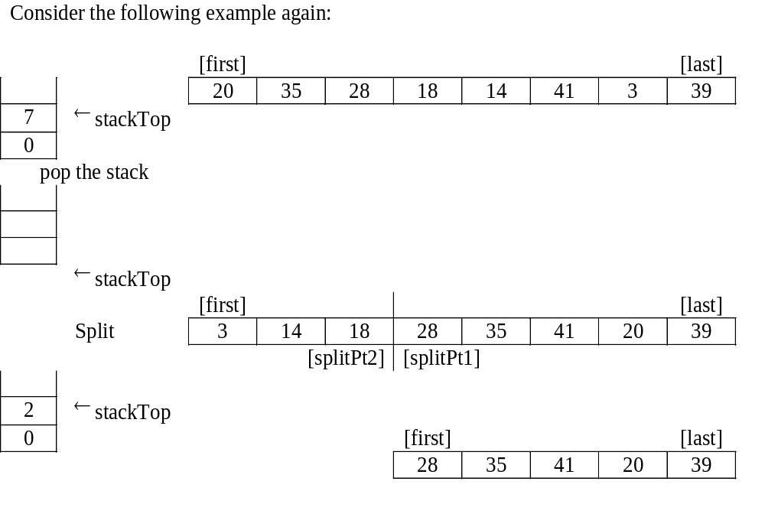

Slide 10
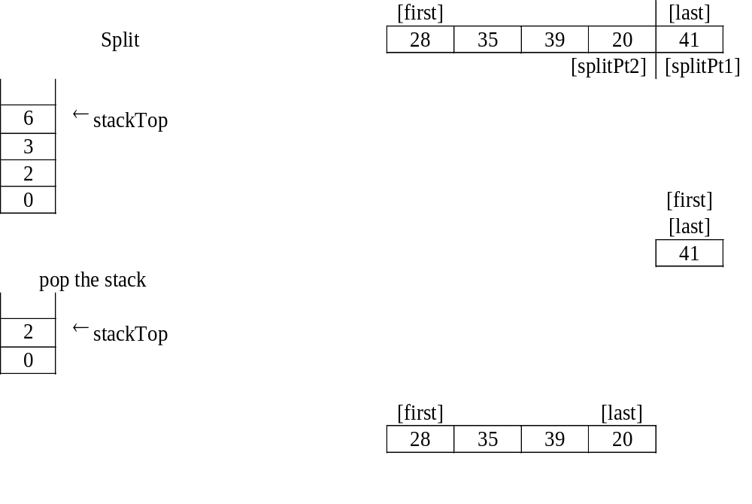

Slide 11
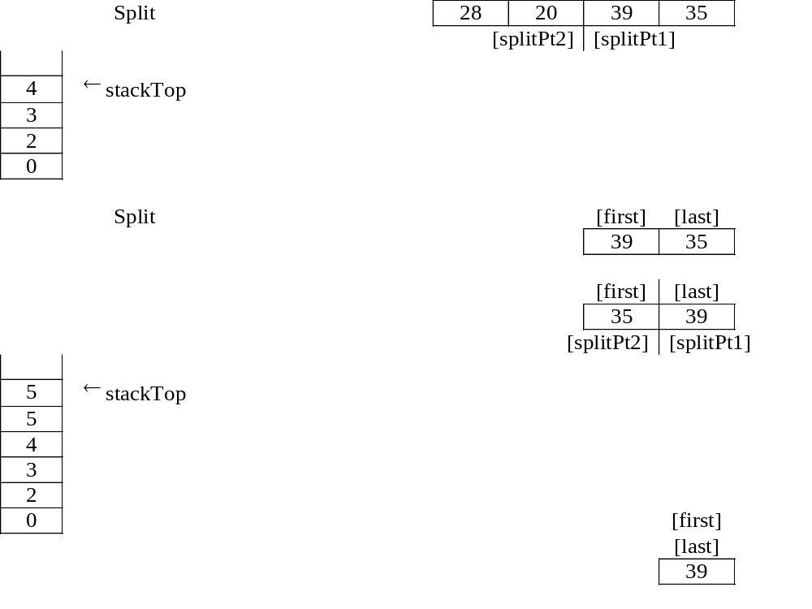

Slide 12
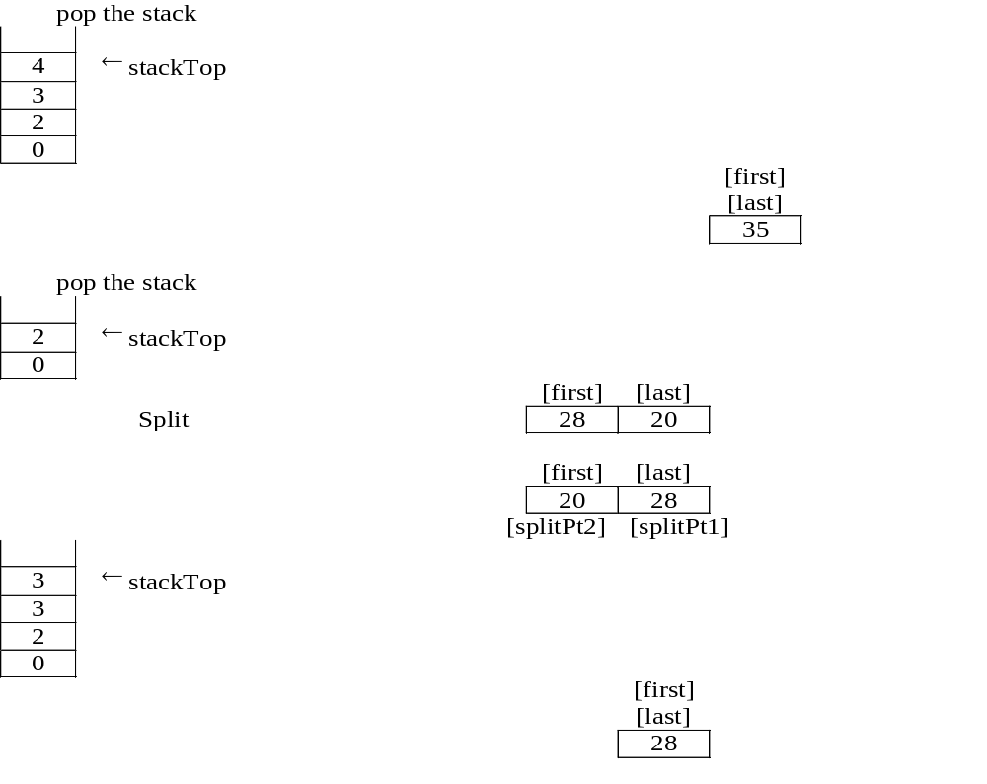

Slide 13
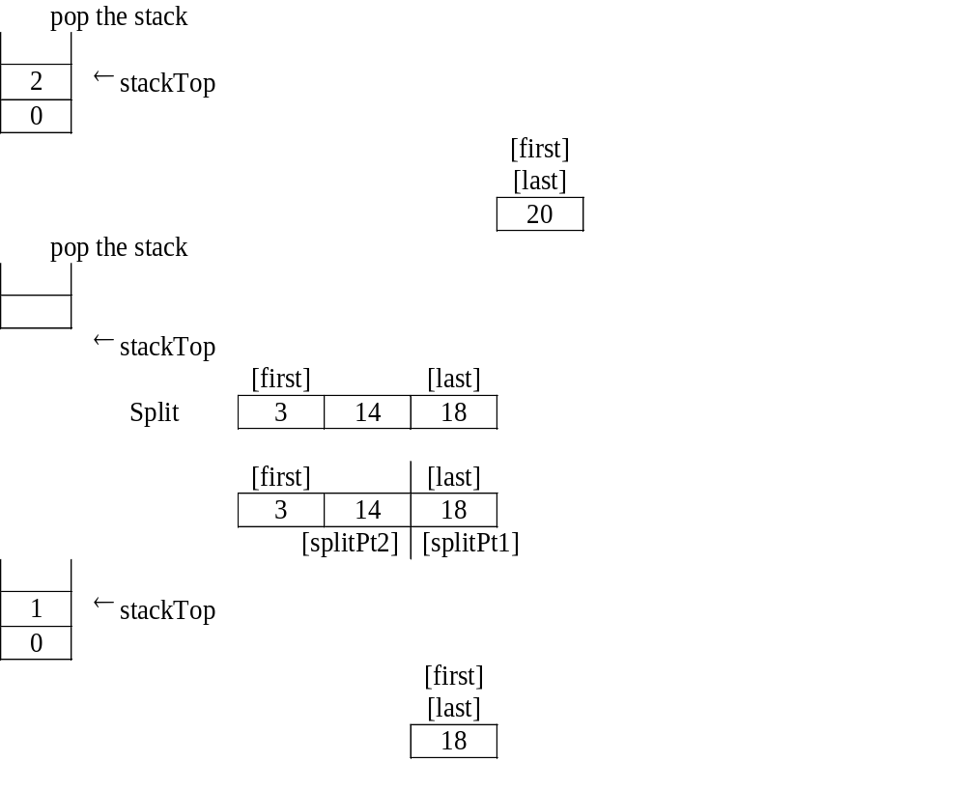

Slide 14
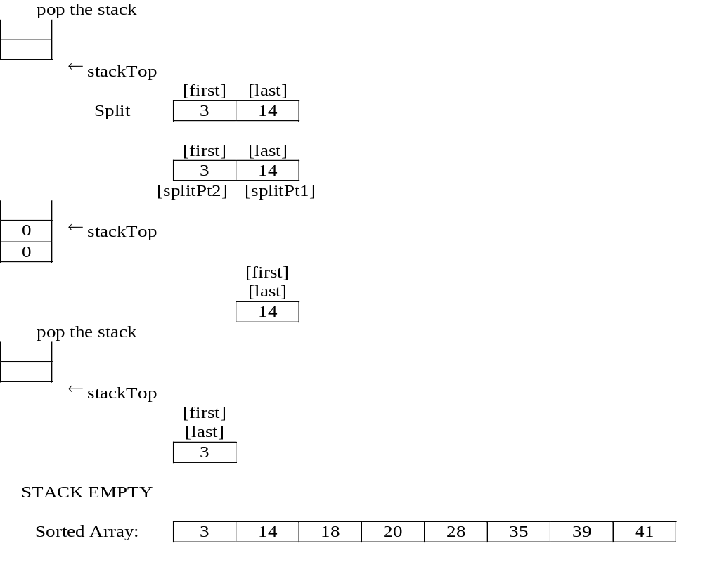

Slide 15
splitVal = 18
3 14 18 28 35 41 20 39
first = 3 last = 7
splitVal = 41
3 14 18 28 35 39 20 41
first = 7 last = 7
splitVal = 35
3 14 18 28 20 39 35 41
first = 5 last = 6
splitVal = 39
3 14 18 28 20 35 39 41
first = 6 last = 6
splitVal = 28
3 14 18 20 28 35 39 41
first = 4 last = 4
splitVal = 14
3 14 18 20 28 35 39 41
first = 2 last = 2
After sort:
3 14 18 20 28 35 39 41
Press any key to continue

